Slide 1

March Madness Report
GUCCIGANG
Tram Ngoc Le, Yanqi Shi, Bao Ngoc Dinh, Kefan Zha

Slide 2
Introduction
One of the most famous and popular sporting events annually in the United States
Formed by 68 Division I level college basketball team
To generate a national champion ship, the competition is divided by several rounds into:
First Four
First and Second Round
Sweet 16/Elite Eight
Final
The prediction on results of March Madness is a popular culture in the United States.

Slide 3
Problem Statement
What are we proposed to do?
Descriptive analytics with visualization on data from 2002 to 2019.
Prediction model building on data from 2002 to 2019.
Why is this important?
A reference for people who are interested in predicting the game.
Used by NCAA teams to make improvement for their performance.
Used by NCAA to adjust their marketing strategies such as ticket price sales.

Slide 4
Methodology Diagram
Data Preprocessing
Derived new variables
Data Split
Prediction
Model Evaluation
Log loss
Accuracy
Variables Selection
Forward Selection Procedures
Analysis Based on Prediction
Visualization
Prediction
Model Building
Logistic regression
Random forest
Linear discriminant analysis (LDA)
Quadratic discriminant analysis (QDA)
Support vector machine (SVM)
Exploratory Analysis
Visualization

Slide 5
Data Preprocessing
Derived Novel Variables
Team’s winning rate – Calculated as ‘wins/(wins+losses)’.
Team’s win-loss ratio – Calculated as ‘wins/losses’.
Coach’s winning rate – Calculated as ‘wins/(wins+losses)’.
Coach’s win-loss ratio – Calculated as ‘wins/losses’.
Seed Differences – Calculated as ‘strong seed - weak seed’.
Whether team 1 wins – Derived by scores after randomly switch team 1 and team 2.
Variables Removal
Remove two teams’s variables in association with wins and losses.
Split Data (Used in prediction model building)
Training Data: 2002 – 2018; Test Data: 2019
Data needed prediction: 2020

Slide 6
Hypotheses
Hypothesis 1:
A team’s defense and offense are both important. Thus, a team with excellent offense and defense will have a bigger likelihood of winning.
Hypothesis 2:
The team’s seed number is a big factor in their probability of winning. In other words, the stronger the seed, the bigger the likelihood of winning.

Slide 7
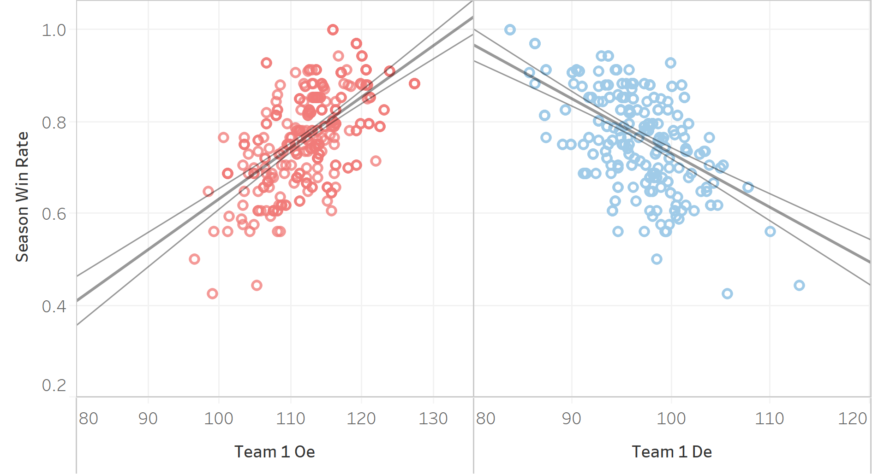
Exploratory Analysis I
Figure 1 show the relationship between the season win rate for a team vs. its offensive points and defensive points.
There is a positive correlation between offense points and season win rate. The higher offensive possession points a team scored, the higher win rate the team will get. There is a negative correlation between defense points and season win rate. The higher defensive possession points a team allows its opponent to score, the lower win rate the team will get.
Both offense power and defense power affect the win rate.
Figure 1. Scatter Plot – Trend Line: Season Win Rate vs. Offense Points and Defense Points (2015-2019)

Slide 8
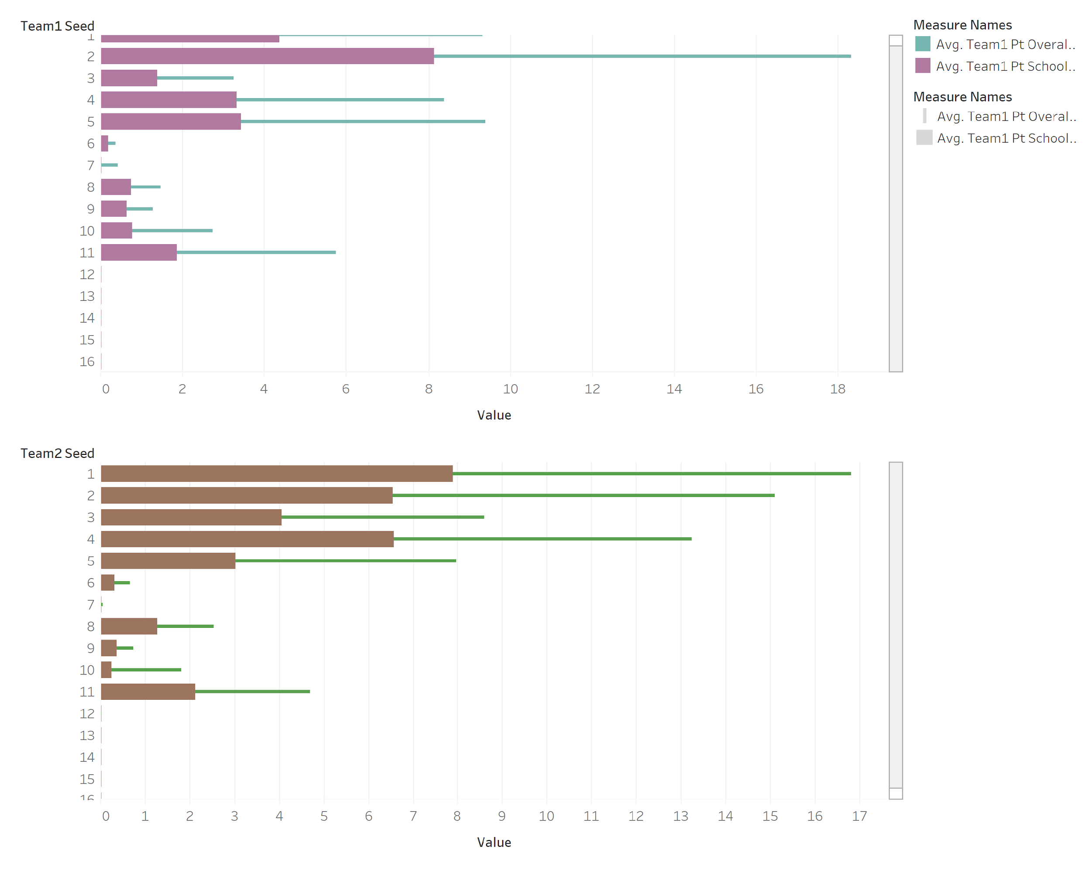
Exploratory Analysis II
Figure 2 demonstrate a comparison of the number of NCAA Sweet Sixteen appearances at current school vs career overall number of NCAA Sweet Sixteen appearances in 2019.
The smaller the seed number, the bigger the amount of appearances, whether it’s overall or at current school. For seed number bigger than 12, the appearance at sweet sixteen is very rare.
Seed can be considered as a big factor in predicting the probability of winning.
Figure 2. Bar Chart – Comparison of number of NCAA Sweet Sixteen appearances at current school and career overall number of NCAA Sweet Sixteen appearances (2019)

Slide 9
Variable Selection
Forward Selection Procedures – Choose the most significant variables.
Pick the explanatory variables combination with lowest BIC (Figure 3),
which consists of 9 variables:
Team1_seed, Team2_seed, Team1_oe, Team2_oe, Team1_de,
Team2_de, Team2_pt_school_s16, Team1_pt_overall_s16, Team1_arate
Since we randomly switch team 1 and team 2 in data
preprocessing, we add relevant variables above for both team 1
and team 2.
These selected variables correspond to our exploratory analysis.
Detailed data dictionary is shown on next slide.
Figure 3: BIC value in subset selection

Slide 10
Variable Name | Scale | Description | Variable Type
Team1_seed | Ordinal | Team 1’s seed in the tournament, ranking team power (1 is the strongest) | Explanatory Variable
Team2_seed | Ordinal | Team 2’s seed in the tournament, ranking team power (1 is the strongest) | Explanatory Variable
Team1_arate | Ratio | Team 1’s percentage of field goals that were preceded by an assist | Explanatory Variable
Team2_arate | Ratio | Team 2’s percentage of field goals that were preceded by an assist | Explanatory Variable
Team1_oe | Continuous | Team 1’s offensive power - Points scored per 100 offensive possessions | Explanatory Variable
Team2_oe | Continuous | Team 2’s offensive power - Points scored per 100 offensive possessions | Explanatory Variable
Team1_de | Continuous | Team 1’s defensive power - Points allowed per 100 defensive possessions | Explanatory Variable
Team2_de | Continuous | Team 2’s defensive power - Points allowed per 100 defensive possessions | Explanatory Variable
Team1_pt_school_s16 | Continuous | Team 1’s number of NCAA Sweet Sixteen appearances at current school | Explanatory Variable
Team2_pt_school_s16 | Continuous | Team 2’s number of NCAA Sweet Sixteen appearances at current school | Explanatory Variable
Team1_pt_overall_s16 | Continuous | Team 1’s career overall number of NCAA Sweet Sixteen appearances | Explanatory Variable
Team2_pt_overall_s16 | Continuous | Team 2’s career overall number of NCAA Sweet Sixteen appearances | Explanatory Variable
Team1_pt_team_season_winrate | Ratio | The possibility of a team 1 to win in this season | Explanatory Variable
Team2_pt_team_season_winrate | Ratio | The possibility of a team 2 to win in this season | Explanatory Variable
Team1_pt_coach_season_winrate | Ratio | The possibility of winning if this coach of team 1 is in charge this season | Explanatory Variable
Team2_pt_coach_season_winrate | Ratio | The possibility of winning if this coach of team 2 in charge this season | Explanatory Variable
Team1_WoLI | Binary | Team 1’s result of win or loss (1=WIN, 0=LOSS) | Response Variable
Game_id | Nominal/Numeric | The identification number of a game | Unique Identifier
Season | Date | The year of season | Control Variable
Team1_id | Nominal/Numeric | Team 1’s identification number | Control Variable
Team2_id | Nominal/Numeric | Team 2’s identification number | Control Variable

Slide 11
Prediction Model Building
Logistic regression
Random forest
Linear discriminant analysis (LDA)
Quadratic discriminant analysis (QDA)
Support vector machine (SVM)
 | Logistic regression | Random forest | LDA | QDA | SVM
Log loss | 0.5402133 | 0.5227263 | 0.5378359 | 0.9806795 | 0.6019181
Accuracy | 71.64% | 71.64% | 73.13% | 67.16% | 67.16%

Slide 12
Model Summary – Random Forest
5 variables are randomly sampled as candidates at each split
600 trees to grow
Random forest would give different vote results each time since it is ‘random’
Repeat training procedure 500 times to pick the best ‘forest’
Final model’s performance on test data:
Log loss: 0.4997394
Accuracy: 71.64%

Slide 13
Analysis Based on Prediction - Likelihood
Likelihood | Probability
Most Likely to Win | p >= 0.95
Likely to win | 0.68 <= p < 0.95
50-50 case | 0.32 < p < 0.68
Likely to Lose | 0.05 < p <=0.32
Most Likely to Lose | p <= 0.05
Figure 4. Pie Chart: Team 1 Winning Probability Distribution
Figure 4 shows the percentage of likelihood for team 1 winning the game.
Nearly 50% of the games will be a 50-50 case. Only 4.2% of the games will be ‘easy games’.
People can choose 50-50 case games to watch since these games may be in a stalemate.

Slide 14
Analysis Based on Prediction - Upsets
Figure 5 shows the predicted upsets with seed difference larger than 4. Upsets with large seed difference or with high odds are labeled.
8 games are predicted to be upsets with high odds, which means the weaker team has relatively high probability to beat the stronger team; 7 games are predicted to be upsets with large seed difference, which means a much weaker team may beat a much stronger team.
Both audience and NCAA should give attention to these games since they may have results against all expectations.
Figure 5. Scatter plot: Seed Difference vs. Winning Odds in Upsets

Slide 15
Conclusion & Improvement
Conclusion
A reasonable model of March Madness prediction has been established.
The likelihood of winning for games in March Madness 2020 has been obtained.
Some potential upsets are predicted for people who are interested in.
Limitation & Improvement
Limited sample size and large time span of the training data could weaken our model.
More implicit variables and more complex algorithms may improve the accuracy and reduce the log loss.

Slide 16
Reference
Adit, D. (2017, March 12). Applying Machine Learning To March Madness. Retrieved from https://adeshpande3.github.io/Applying-Machine-Learning-to-March-Madness
Conor, D. (2018, March 15). Machine Learning Madness: Predicting Every NCAA Tournament Matchup. Retrieved from https://towardsdatascience.com/machine-learning-madness-predicting-every-ncaa-tournament-matchup-7d9ce7d5fc6d
Kaggle. (2017, April 4). March Machine Learning Mania 2017. Retrieved from https://www.kaggle.com/c/march-machine-learning-mania-2017
Lotan, W. (2019, April 21). How We Predicted March Madness Using Machine Learning. Retrieved from https://medium.com/@lotanweininger/march-madness-machine-learning-2dbacc948874

